Slide 1

CONTINUOUS SYSTEM

Slide 2
CONTINUOUS SYSTEM
Number of five digits can follow the combinations given below (with example):
Five different digits = 12345
Pairs = 22960
Two pairs = 55996
Three of a kind = 52228
Full houses = 77766
Four of a kind = 83333
Five of a kind = 11111

Slide 3
CONTINUOUS SYSTEM
QUESTION - 1
Consider a case where two chemicals ch₁ and ch₂ react to produce a third chemical ch_{3.} If c₁ , c₂ and c₃ are the amounts of ch_{1 ,} ch₂ and ch₃ at any instant of time t, the rates of increase of c₁ , c₂ and c₃ are given by the foll wing differential equations:
dc₁/dt = k₂c₃ - k₁c₁c₂
dc₂/dt = k₂c₃ - k₁c₁c₂
dc₃/dt = 2k₁c₁c₂ - 2k₂c₃
where k₁ and k₂ are constants.
As soon as the chemicals ch₁ and ch₂ are mixed, the reaction starts and the amounts c₁, c₂ and c₃ in the mixture go on changing at the time progresses. Find the amounts of the chemicals at 1 sec. time considering the time interval as 0.1 sec? When t = 0.0sec the amounts c₁ ,c₂ and c₃ are 50.0, 25.0 and 0.0 units respectively. The constants k₁ and k₂ are 0.025 and 0.01 respectively.

Slide 4
CONTINUOUS SYSTEM
ANSWER
c₁ (t+∆t) = (c₁(t) + [ dc₁(t) / dt ] ∆t
= (c₁(t) + [ k₂c₃(t) - k₁c₁(t)c₂(t) ] ∆t
c₂ (t+∆t) = (c₂(t) + [ dc₂(t) / dt ] ∆t
= (c₂(t) + [ k₂c₃(t) - k₁c₁(t)c₂(t) ] ∆t
c₃ (t+∆t) = (c₃(t) + [ dc₃(t) / dt ] ∆t
= (c₃(t) + [ k₂c₃(t) - k₁c₁(t)c₂(t) ] ∆t
Here,
c₁ (0) = 50.0, c₂ (0) = 25.0, c₃ (0) = 0.0, k₁ =0.025, k₂ = 0.01
c₁ (0+0.1)= (c₁(0) + [ k₂c₃(0) - k₁c₁(0)c₂(0) ] 0.1 = (50 + [ 0.01*0.00 – 0.025*50*25 ] 0.1 = 46.88
c₁ (0.1+0.1) = (c₁(0.1) + [ k₂c₃(0.1) - k₁c₁(0.1)c₂(0.1) ] 0.1

Slide 5
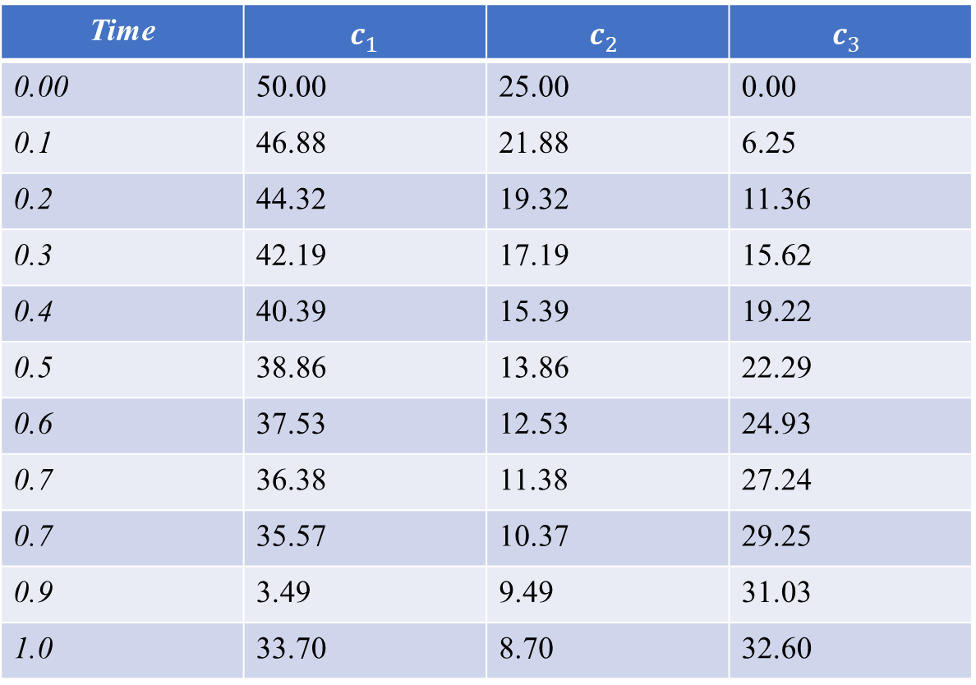
CONTINUOUS SYSTEM
Time | $c_{1}^{}$ | $$c_{2}^{}$$ | $$c_{3}^{}$$
0.00 | 50.00 | 25.00 | 0.00
0.1 | 46.88 | 21.88 | 6.25
0.2 | 44.32 | 19.32 | 11.36
0.3 | 42.19 | 17.19 | 15.62
0.4 | 40.39 | 15.39 | 19.22
0.5 | 38.86 | 13.86 | 22.29
0.6 | 37.53 | 12.53 | 24.93
0.7 | 36.38 | 11.38 | 27.24
0.7 | 35.57 | 10.37 | 29.25
0.9 | 3.49 | 9.49 | 31.03
1.0 | 33.70 | 8.70 | 32.60

